Slide 1
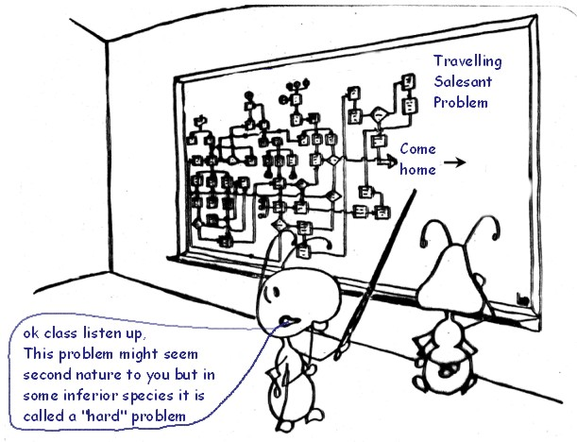
Swarm Intelligence: Ant Colony Optimization

Slide 2
Swarm Intelligence
Swarm Intelligence (SI) is the property of a system whereby the collective behaviors of (unsophisticated) agents interacting locally with their environment cause coherent functional global patterns to emerge.
SI provides a basis with which it is possible to explore collective (or distributed) problem solving without centralized control or the provision of a global model.
Leverage the power of complex adaptive systems to solve difficult non-linear stochastic problems

Slide 3
Swarm Intelligence
Characteristics of a swarm:
Distributed, no central control or data source;
Limited communication
No (explicit) model of the environment;
Perception of environment (sensing)
Ability to react to environment changes.

Slide 4
Swarm Intelligence
Social interactions (locally shared knowledge) provides the basis for unguided problem solving
The efficiency of the effort is related to but not dependent upon the degree or connectedness of the network and the number of interacting agents

Slide 5
Swarm Intelligence
Robust exemplars of problem-solving in Nature
Survival in stochastic hostile environment
Social interaction creates complex behaviors
Behaviors modified by dynamic environment.
Emergent behavior observed in:
Bacteria, immune system, ants, birds
And other social animals

Slide 6
Ants – Swarm Intelligence Example
Franks observed Lasius Niger ants,
regulation of 1 degree Celsius range;
forming bridges;
raiding specific areas for food;
building and protecting nest;
sorting brood and food items;
cooperating in carrying large items;
emigration of a colony;
finding shortest route from nest to food source;
preferentially exploiting the richest food source available.
Without Any Central Leadership or Control

Slide 7
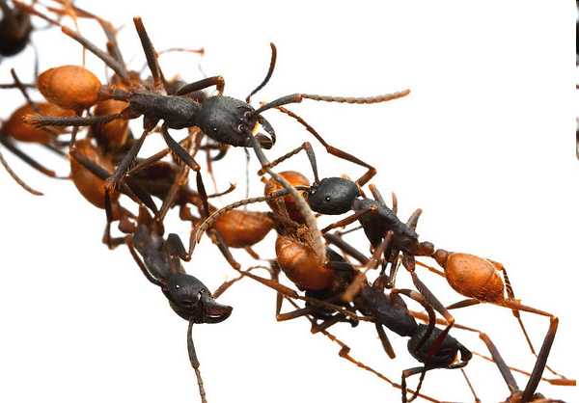
Ants – Swarm Intelligence Example
forming bridges:

Slide 8
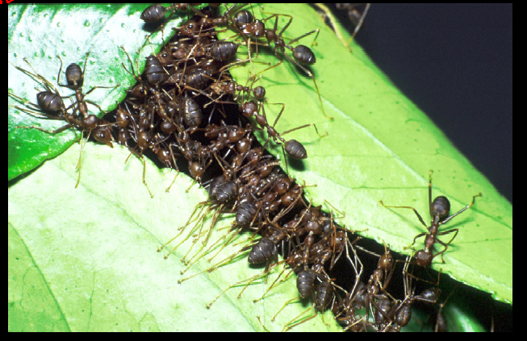
Ants – Swarm Intelligence Example
Cooperating in large tasks:

Slide 9
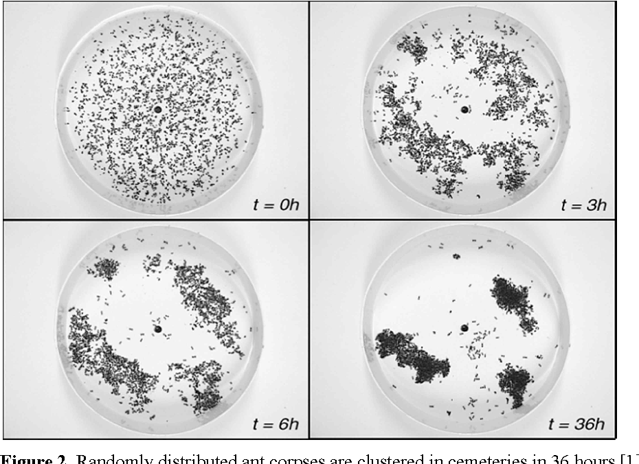
Ants – Swarm Intelligence Example
Clustering:

Slide 10
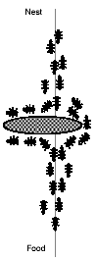
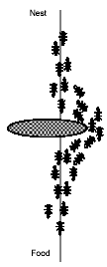
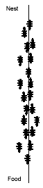
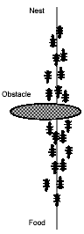
Natural behavior of ant: Foraging

Slide 11
Ant Colony Optimization: Introduction
First proposed by M. Dorigo, 1992
Multi-agent approach for solving difficult combinatorial optimization problems
Ants are essentially blind, deaf and dumb.
Ants are social creatures – behavior directed to survival of colony
Q: how can ants find the short path to food sources?
Ants deposit pheromones on ground that form a trail. The trail attracts other ants.

Slide 12
Ant Colony Algorithms
Ant behavior is a kind of stochastic distributed optimization behavior.
Although one ant is capable of building a solution, it is the behavior of an ensemble of ants that exhibits the shortest path behavior.
The behavior is induced by indirect communication (pheromone paths) without central control.

Slide 13
Ant Colony Algorithms
Ants do not know the global structure of the problem - discover the network
Limited ability to sense local environment - can only “see” adjacent nodes of immediate neighborhood.
Each ant chooses an action based on variable probability
random choice
pheromone mediated

Slide 14
Ant Colony Algorithms
Each ant collects information about local environment; acts concurrently and independently
No direct communication: stigmergy paradigm governs information exchange
Incremental constructive approach to building solutions
High quality solutions emerge via global cooperation.

Slide 15
Stigmergy
Indirect communication via interaction with environment [Gassé, 59, Wilson, 75]
Sematonic stigmergy
action of agent directly related to problem solving and affects behavior of other agents.
Sign-based stigmergy
action of agent affects environment not directly related to problem solving activity.

Slide 16
Pheromone Trails
Species lay pheromone trails traveling from nest, to nest or possibly in both directions.
Pheromones evaporate.
Pheromones accumulate with multiple ants using path.
_{Food source}
_{Nest}

Slide 17
Pheromone Trails Example
_{E}
_{E}
_{E}
_{T = 0}
_{T = 1}
_{30 ants}
_{30 ants}
_{D}
_{D}
_{D}
_{15 ants}
_{15 ants}
_{10 ants}
_{20 ants}
_{d=1.0}
_{d=0.5}
_{H}
_{C}
_{H}
_{C}
_{H}
_{C}
_{d=1.0}
_{d=0.5}
_{10 ants}
_{20 ants}
_{B}
_{15 ants}
_{B}
_{15 ants}
_{B}
_{30 ants}
_{30 ants}
_{A}
_{A}
_{A}
Notes:
Distances are 1 or 0.5 in graph.
Consider discretized intervals t=0, 1, 2.
Suppose that 30 new ants come from A to B every time unit and 30 from E to D. Each ant walks at a speed of 1 per time unit, and that an ant lays down at time t a pheromone of intensity 1 while walking and that this evaporates completely and instantaneously in the middle of time intervals (t+1, t+2).
At t=0, there is no trail yet but 30 ants are in B and 30 in D. Their choice of direction is random. Therefore, on average 15 will go to H and 15 to C.
At t=1, the 30 new ants come to B from A and find a trail of intensity 15 on the path that leads to H, laid by the 15 ants that went that way from B, and a trail of intensity 30 on the path to C obtained as the sum of the trail laid by the 15 ants that went that way from B and by the 15 ants that reached B coming from D via C. The probability of choosing a path is therefore biased, so that the expected number of ants going towards C will be double that of those going towards H. The same is true for the new 30 ants in D which came from E.
Process continues until all ants choose the shortest path. The idea is that if at a given point an ant has to choose among different paths, those which were heavily chosen by preceding ants are chosen with higher probability.
This is an example of an autocatalytic process.

Slide 18
Ant Colony example
Pheromone mediated “following” behavior induces the emergence of shortest paths.
Probability of choosing a branch of a path at a certain time depends on the total amount of pheromone on the branch.
The choice is proportional to the number of ants that have used the branches.

Slide 19
Ant Colony example
Let u_{m} and l_{m} be the number of ants that have used the upper and lower branches.
The probability P_{u}(m) with which the (m+1)^{th} ant chooses the upper branch is:

Slide 20
Algorithm
While ( termination not satisfied )
create ants
Starting point depends on problem constraints
Initial pheromone is > 0, but very small
Find solutions
Pheromone evaporation
Daemon activities {optional}

Slide 21
Algorithm
Find solutions
Transition probability:
Quantity of pheromone
Heuristic distance
α,β constants

Slide 22
Algorithm
Pheromone update
Pheromone laid by each ant that uses edge (i,j)
Evaporation rate

Slide 23
Algorithm
Daemon activities {optional}
Usually, a local search algorithm is employed here
May also appear after “Find solutions” stage
(A daemon is a program that runs continuously in the background of a multitasking operating system)

Slide 24
Requirements
Problem being solved must be in graphical format
Since algorithm is based on path finding behavior
Not always apparent
Must be finite (must have a start and end)

Slide 25
Traveling Salesperson Problem
Famous NP-Hard Optimization Problem
Given a fully connected, symmetric G(V,E) with known edge costs, find the minimum cost tour.
Artificial ants move from vertex to vertex in order to find the minimum cost tour using only pheromone mediated trails.

Slide 26
TSP
The three main ideas that this ant colony algorithm has adopted from real ant colonies are:
The ants have a probabilistic preference for paths with high pheromone value
Shorter paths tend to have a higher rate of growth in pheromone value
It uses an indirect communication system through pheromone in edges

Slide 27
TSP
Ants select the next vertex based on a weighted probability function based on two factors:
The number of edges and the associated cost
The trail (pheromone) left behind by other ant agents.
Each agent modifies the environment in two different ways :
Local trail updating: As the ant moves between cities it updates the amount of pheromone on the edge
Global trail updating: When all ants have completed a tour the ant that found the shortest route updates the edges in its path

Slide 28
TSP
Local Updating is used to avoid very strong pheromone edges and hence increase exploration (and hopefully avoid locally optimal solutions).
The Global Updating function gives the shortest path higher reinforcement by increasing the amount of pheromone on the edges of the shortest path.

Slide 29

A simple TSP example
[]
1
[]
A
B
2
[]
C
3
[]
4
D
E
[]
d_{AB} =100;d_{BC} = 60…;d_{DE} =150
5

Slide 30
Iteration 1
[A]
[B]
1
A
2
B
[C]
3
C
[D]
[E]
D
5
4
E

Slide 31
How to build next sub-solution?
[A]
1
A
B
[A]
C
1
[A]
1
[A,D]
[A]
1
1
D
E

Slide 32
Iteration 2
[E,A]
[C,B]
5
A
3
B
[B,C]
2
C
[A,D]
[D,E]
1
D
4
E

Slide 33
Iteration 3
[D,E,A]
[E,A,B]
4
5
A
B
[A,D,C]
1
C
[B,C,D]
[C,B,E]
2
D
3
E

Slide 34
Iteration 4
[B,C,D,A]
[D,E,A,B]
2
A
4
B
[E,A,B,C]
5
C
[C,B,E,D]
[A,DCE]
D
3
1
E

Slide 35
Iteration 5
[C,B,E,D,A]
[A,D,C,E,B]
3
1
A
B
[D,E,A,B,C]
4
C
[E,A,B,C,D]
[B,C,D,A,E]
D
5
E
2

Slide 36
Path and Pheromone Evaluation
[A,D,C,E,B]
L₁ =300
1
[B,C,D,A,E]
L₂ =450
2
[C,B,E,D,A]
L₃ =260
3
[D,E,A,B,C]
L₄ =280
4
[E,A,B,C,D]
L₅ =420
5

Slide 37
End of First Run
Save Best Tour (Sequence and length)
All ants die
New ants are born

Slide 38
Ant System (Ant Cycle)
t = 0; NC = 0; τ_{ij}(t)=c for ∆τ_{ij}=0
Place the m ants on the n nodes
Initialize
Update tabu_{k}(s)
Tabu list management
Choose the city j to move to. Use probability
Move k-th ant to town j. Insert town j in tabu_{k}(s)
Compute the length L_{k} of every ant
Update the shortest tour found
=
For every edge (i,j)
Compute
For k:=1 to m do
Yes
Yes
NC<NC_{max}
&& not stagn.
Set t = t + n; NC=NC+1; ∆τ_{ij}=0
No
End

Slide 39
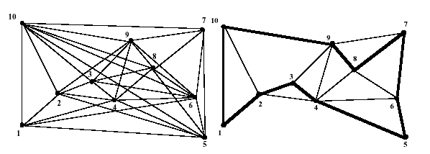
Stopping Criteria
Stagnation
Max Iterations

Slide 40
Comparison to Meta-Heuristic Algorithms
Compared Ant Colony Algorithm to standard algorithms and meta-heuristic algorithms on Oliver 30 – a 30 city TSP
Comparing ACO to other Meta-heuristics provides a “fair market” comparison (vice TSP specific algorithms).
 | Best | Mean | Std Dev
ACO | 420 | 420.4 | 1.3
Tabu | 420 | 420.6 | 1.5
SA | 422 | 459.8 | 25.1

Slide 41
Other Application Areas
Scheduling : Scheduling is a widespread problem of practical importance.
Paul Forsyth & Anthony Wren, University of Leeds Computer Science department developed a bus driver scheduling application using ant colony concepts.

Slide 42
Other Application Areas
Telecommunication Networks : Network routing refers to the activity of creating, maintaining and using routing tables (one for each node in the network) to determine where to direct an incoming data stream so that it can continue its travel through the network.
In telecommunications, this is an extremely difficult problem because of the constant changes in network traffic load. The Ant Colony algorithm provides adaptive advantages that can adjust to traffic load.

Slide 43
Other Application Areas
Vehicle Routing Problem: The VRP is similar to the TSP, but is complicated by multiple vehicles, vehicle capacity, pick-up and drop off points (which can dictate vehicle packing and scheduling).
Bernd Mullenheimer, Richard Hartl and Christine Strauss developed an Ant Colony algorithm for solving the VRP

Slide 44
General design criteria
Number of ants
Balance of exploration and exploitation
Combination with greedy heuristics or local search
When are pheromones updated?

